Slide 1

HSVmode:HSV
Progress Report
2026 W15 - W16
Name: Liu Zhaolin
Date: 19/04/2026

Slide 2
CONTENTS
1. Progress Report for the Past Two Weeks
2. Project Plan for the Next Two Months

Slide 3
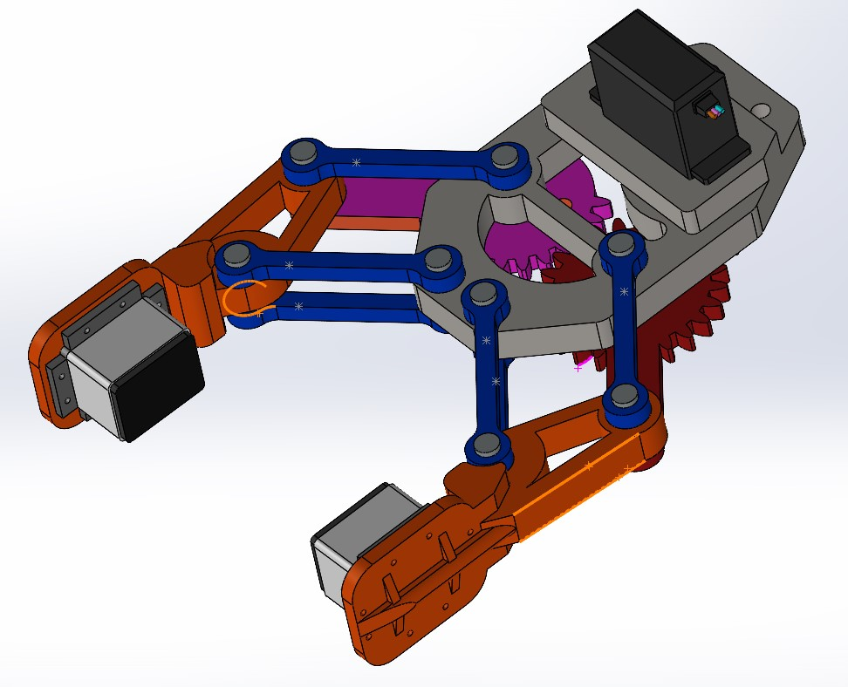
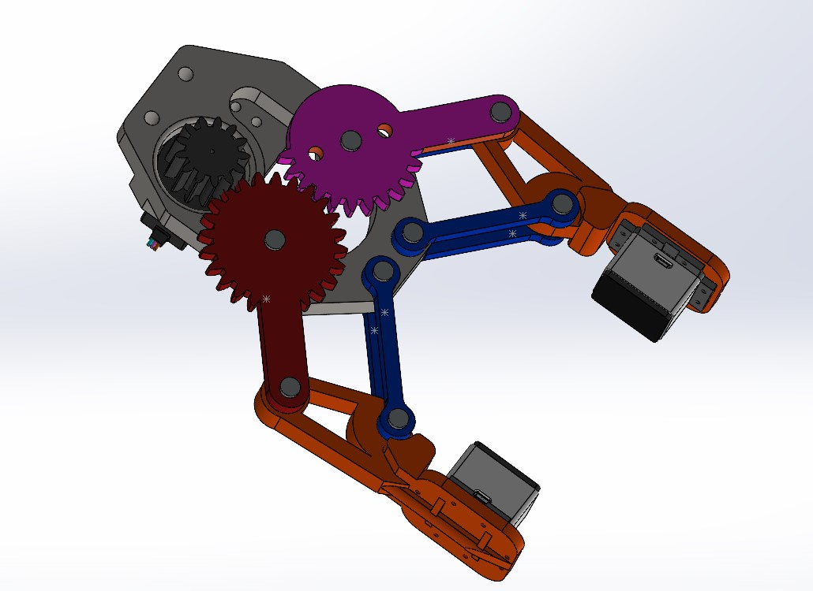
1.1 Gripper Design & Tactile Feedback Loop
Aimming to provide a reliable physical validation platform for the application and performance testing of tactile sensors，I designed a robotic gripper.

Slide 4
1.1 Gripper Design & Tactile Feedback Loop
The Principles of Visuo-Tactile Closed-Loop Control：
Phase 1: Pre-Calibration & Initial Approach
Calibration Force Setting: Upon system initialization, a safe and basic "calibration grasping force" is preset as the initial target.
Initial Closure: The controller sends an open-loop command to the MG996R servo, driving the gripper to close until the silicone surface just contacts the object and reaches an initial, slight force state.
Phase 2: Photometric Perception & 3D Reconstruction
Capturing Illumination Distortion: As the silicone deforms under pressure, the light intensity and shadows generated by the internal LED array change subtly. The OV5640 camera captures these high-resolution image signals in real-time.
Image to Tactile Force: The Raspberry Pi uses photometric stereo algorithms to perform a 3D geometric reconstruction of the contact surface based on light intensity changes, thereby accurately calculating the current physical contact force and stress distribution.

Slide 5
1.1 Gripper Design & Tactile Feedback Loop
Phase 3: Error Calculation & Dynamic Fine-Tuning
Real-Time Correction: The Raspberry Pi calculates the error between the "3D-reconstructed real-time force" and the "calibration force" at a high frequency.
Flexible Adaptation: If the current force is less than the calibration force, it fine-tunes the PWM signal to slowly increase pressure; if the force is too high, it slightly opens the gripper. Through this millimeter-level dynamic adjustment, it achieves a perfect "soft grasp" on fragile or unknown-hardness objects.
Phase 4: Slip Warning & Transient Response
Shear Force Monitoring: During the 3D reconstruction, if dynamic downward displacement of the contact surface texture is detected (i.e., a sudden change in shear force), the system immediately determines that the object is slipping.
Anti-Slip Interrupt: It triggers the highest-priority control, instantaneously increasing the servo's closing angle to lock the object, and automatically switches back to the regular force fine-tuning loop once stabilized.

Slide 6
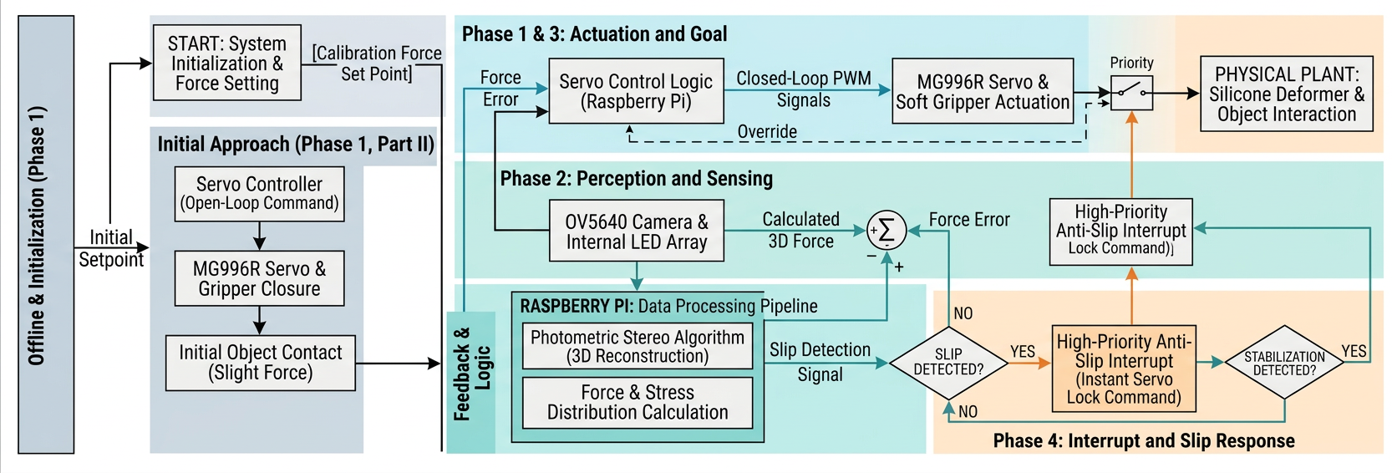
1.1 Gripper Design & Tactile Feedback Loop

Slide 7
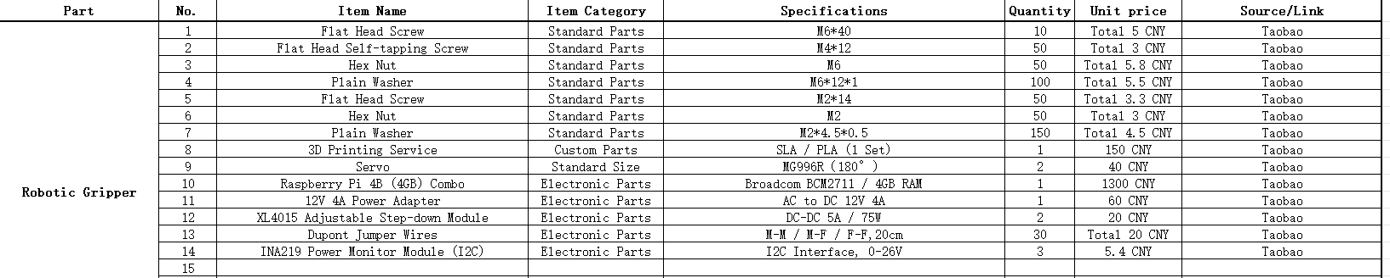
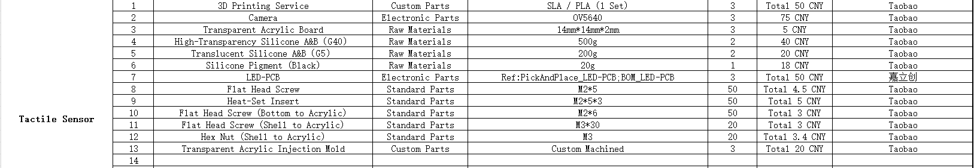
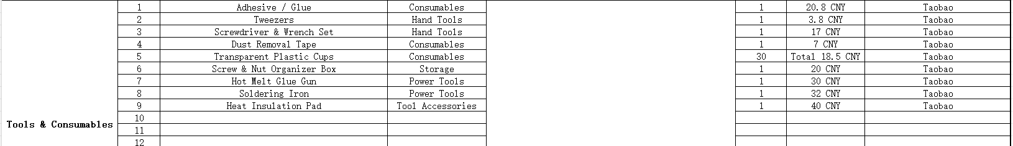
1.2 Refining the BOM details

Slide 8
02.
Project Plan for the Next Two Months

Slide 9
Plan (Late April - Early July)
Phase 1: Hardware Assembly & Preparation (Late April - Mid May)
Key Tasks:
Complete the silicone molding of the visuo-tactile sensor
Complete the isolated wiring (high/low voltage) of the gripper.
Critical Challenge:
Optical-grade Silicone Molding. A vacuum degasser must be used to ensure the silicone is free of bubbles; otherwise, it will severely disrupt subsequent visual feature extraction.

Slide 10
Plan (Late April - Early July)
Phase 2: Visuo-Tactile Model Training & Calibration (Mid May - Mid June). . . . .[CORE FOCUS]
Key Tasks:
Data Collection: Use the lab's 6D force sensor as Ground Truth. Implement strict timestamp synchronization via Python to collect paired datasets of "OV5640 internal deformation images" and "actual 6D force/torque values" during compression.
OpenCV Preprocessing: Use OpenCV to calculate the Difference Image between the loaded frame and the initial frame to filter out static backgrounds. Retain only deformation shadows caused by LED illumination distortion, crop the ROI, and convert to Tensors.
PyTorch Training: Construct a Regression Task neural network on the workstation. Use a lightweight Backbone (e.g., MobileNetV3 or ResNet-18) for feature extraction to output 6D force predictions. Update model weights using MSE Loss and the Adam optimizer.
Critical Challenge:
Spatiotemporal Alignment & Inference Acceleration. Millisecond-level alignment of images and force data is a prerequisite. Meanwhile, the PyTorch model must be exported to ONNX format to ensure real-time control (<50ms per forward pass) on the Raspberry Pi.
High-level AI

Slide 11
Plan (Late April - Early July)
Phase 3: Closed-Loop System Debugging & Optimization (Late June - Early July)
Key Tasks:
Deploy the lightweight model to the Raspberry Pi. Execute the complete closed-loop of "visual force measurement -> error calculation -> PWM servo adjustment", conducting flexible grasping and anti-slip response tests.
Critical Challenge:
Stability of Closed-Loop Response. It requires overcoming the physical latency of the motor and optimizing the trigger sensitivity of the "anti-slip interrupt" mechanism to prevent system oscillation.

